Slide 1
Trauma 101

Slide 2
Session 1: Trauma Facts

Slide 3
What is Trauma?

Slide 4
What is Trauma?
Trauma is witnessing or experiencing an event that poses a real or perceived threat.
Child traumatic stress refers to the physical and emotional responses of a child to threatening situations.
Traumatic events overwhelm a child’s capacity to cope and elicit feelings of terror, powerlessness, and out-of-control physiological arousal.
1 out of every 4 children attending school has been exposed to a traumatic event that can effect learning and/or behavior.

Slide 5
Types of Trauma
Acute
Complex
Chronic
Historic
Medical

Slide 6
Lisa 9-1-1
https://www.youtube.com/watch?v=G_ht2vAYPoc
Immediate Reactions:
What is going on in your mind?
What is happening in your body?

Slide 7
Variability in Responses to Stressors and Traumatic Events
The impact of a potentially traumatic event depends on several factors, including:
The child’s age and developmental stage
The child’s perception of the danger faced
Whether the child was the victim or a witness
The child’s relationship to the victim or perpetrator
The child’s past experience with trauma
The adversities the child faces following the trauma
The presence/availability of adults who can offer help and protection

Slide 8
Effects of Trauma Exposure
Attachment
Biology
Mood regulation
Dissociation
Behavioral control
Cognition
Self-concept
Development

Slide 9
Adverse Childhood Experiences (ACEs)

Slide 10
https://www.cdc.gov/violenceprevention/acestudy/about.html

Slide 11
Understanding Trauma Reminders
Trauma reminders:
When faced with people, situations, places, or things that remind them of traumatic events, children and parents may experience intense and disturbing feelings tied to the original trauma.
These “trauma reminders” can lead to behaviors that seem out of place, but were appropriate—and perhaps even helpful—at the time of the original traumatic event.
Reenactment behaviors in children and parents:
Are familiar and helped them survive in other relationships
“Prove” their negative beliefs and expectations
Help them vent frustration, anger, and anxiety
Give them a sense of mastery over the old traumas

Slide 12
Trauma and the Brain
Trauma can have serious consequences for the brain.
Trauma can adversely affect brain development.
Trauma-exposed children and adolescents display changes in their levels of stress hormones similar to those seen in combat veterans.
Source: Pynoos, R. S., Steinberg, A. M., Ornitz, E. M., & Goenjian, A. K. (1997). Issues in the developmental neurobiology of traumatic stress. Annals of the New York Academy of Sciences, 821, 176-193.

Slide 13
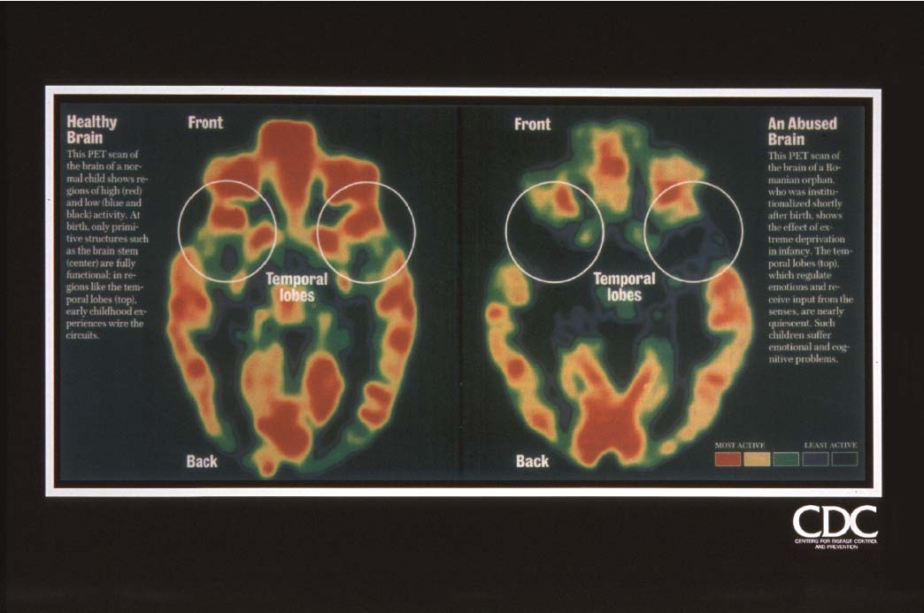
Impact of Extreme Deprivation on Brain Development

Slide 14
Session 2: Trauma Effects per Age / Stage
Psychological and Behavioral Impact of Trauma

Slide 15
Preschool Aged Children
Separation Anxiety
Regression in previously mastered stages of development
Recreating the traumatic event
Difficulty at naptime or bedtime
Increased somatic complaints
Changes in behavior

Slide 16
Preschool Aged Children
Over and under reacting to physical contact, bright lighting, sudden movements, or loud sounds
Increased distress
Anxiety, fear, and worry about safety of self and others
Worry about recurrence of the traumatic event
New fears
Statements and Questions about death and dying

Slide 17
Elementary School Children
Anxiety, fear, and worry about safety of self and others
Worry about recurrence of violence
Increased distress
Changes in behavior:
Increase in activity level
Decreased attention and/or concentration
Withdrawal from others or activities
Angry outbursts and/or aggression

Slide 18
Elementary School Children
Absenteeism
Distrust of others, affecting how children interact with both adults and peers
A change in ability to interpret and respond appropriately to social cues
Increased somatic complaints
Changes in school performance
Recreating the event
Over- or under-reacting to bells, physical contact, doors slamming, sirens, lighting, sudden movements

Slide 19
Elementary School Children
Statements and questions about death and dying
Difficulty with authority, redirection, or criticism
Re-experiencing the trauma
Hyperarousal
Avoidance behaviors
Emotional numbing

Slide 20
Middle School Children
Anxiety, fear, and worry about safety of self and others
Worry about recurrence or consequences of violence
Decreased attention and/or concentration
Increase in activity level
Change in academic performance
Irritability with friends, teachers, events

Slide 21
Middle School Children
Angry outbursts and/or aggression
Withdrawal from others or activities
Absenteeism
Increased somatic complaints
Discomfort with feelings (such as troubling thoughts of revenge)

Slide 22
Middle School Children
Repeated discussion of event and focus on specific details of what happened
Over- or under-reacting to bells, physical contact, doors slamming, sirens, lighting, sudden movements
Re-experiencing the trauma
Hyperarousal
Avoidance behaviors
Emotional numbing

Slide 23
High School Children
Anxiety, fear, and worry about safety of self and others
Worry about recurrence or consequences of violence
Changes in behavior:
Withdrawal from others or activities
Irritability with friends, teachers, events
Angry outbursts and/or aggression
Change in academic performance
Decreased attention and/or concentration
Increase in activity level

Slide 24
High School Children
Absenteeism
Increase in impulsivity, risk-taking behavior
Discomfort with feelings
Increased risk for substance abuse
Discussion of events and reviewing of details
Negative impact on issues of trust and perceptions of others
Over- or under-reacting to bells, physical contact, doors slamming, sirens, lighting, sudden movements

Slide 25
High School Children
Repetitive thoughts and comments about death or dying
Heightened difficulty with authority, redirection, or criticism
Re-experiencing the trauma
Hyperarousal
Avoidance behaviors
Emotional numbing

Slide 26
Session 3: What Can We Do To Help Traumatized Children
Notes:
30 Minutes MAX

Slide 27
Enhance Child Well-Being: Resilience
Resilience is the ability to overcome adversity and thrive in the face of risk.
Neuroplasticity allows for rewiring of neural connections through corrective relationships and experiences.
Children who have experienced trauma can therefore develop resilience.
Source: Van der Kolk, B. (2006). Clinical implications of neuroscience research in PTSD. Annals of the New York Academy of Sciences, 1071, 1-17.

Slide 28
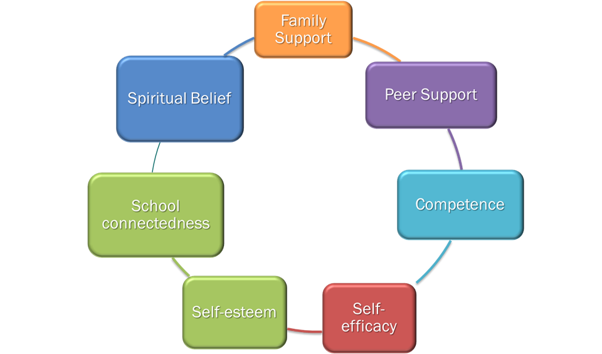
Factors that Enhance Resilience
Sources: Masten, A. S. (2001). Ordinary magic: Resilience processes in development. American Psychologist, 56, 227-238.
National Child Traumatic Stress Network, Juvenile Justice Treatment Subcommittee. (in preparation). Think trauma: A training for staff in juvenile justice residential settings. Will be available from http://www.nctsnet.org/resources/topics/juvenile-justice-system

Slide 29
Enhance Child Well-Being and Resilience
Support and Promote Positive and Stable Relationships
One way to enhance resilience is to ensure that children have access to evidence-based, trauma-informed treatments and services.

Slide 30
Core Components of Trauma-Focused, Evidence-Based Treatment
Building a strong therapeutic relationship
Psychoeducation about normal responses to trauma
Parent support, conjoint therapy, or parent training
Emotional expression and regulation skills
Anxiety management and relaxation skills
Trauma processing and integration
Personal safety training and other important empowerment activities
Resilience and closure
Notes:
30

Slide 31
Questions to Ask Therapists and Agencies That Provide Services
Do you provide trauma-specific or trauma-informed therapy? If so, how do you determine whether the child needs trauma-specific therapy?
How familiar are you with evidence-based treatment models designed and tested for treatment of child trauma-related symptoms?
How do you approach therapy with children and their families who have been impacted by trauma (regardless of whether they indicate or request trauma-informed treatment)?
Describe a typical course of therapy (e.g., can you describe the core components of your treatment approach?).

Slide 32
Day to Day Suggestions to be Proactive with a Traumatized Child

Slide 33
What can be done to help?
Maintain usual routines. A return to “normalcy” will communicate the message that the child is safe and life will go on.
Give children choices. Often traumatic events involve loss of control and/or chaos, so you can help children feel safe by providing them with some choices or control when appropriate.
Increase the level of support and encouragement given to the traumatized child.
Designate an adult who can provide additional support if needed.
Set clear, firm limits for inappropriate behavior and develop logical—rather than punitive—consequences.

Slide 34
What can be done to help?
Recognize that behavioral problems may be transient and related to trauma.
Remember that even the most disruptive behaviors can be driven by trauma-related anxiety.
Provide a safe place for the child to talk about what happened. Set aside a designated time and place for sharing to help the child know it is okay to talk about what happened.
Give simple and realistic answers to the child’s questions about traumatic events.
Clarify distortions and misconceptions. If it isn’t an appropriate time, be sure to give the child a time and place to talk and ask questions.

Slide 35
What can be done to help?
Be sensitive to the cues in the environment that may cause a reaction in the traumatized child.
For example, victims of natural storm-related disasters might react very badly to threatening weather or storm warnings. Children may increase problem behaviors near an anniversary of a traumatic event.
Anticipate difficult times and provide additional support. Many kinds of situations may be reminders. If you are able to identify reminders, you can help by preparing the child for the situation. For instance, for the child who doesn’t like being alone, provide a partner to accompany him or her to the restroom.

Slide 36
What can be done to help?
Warn children if you will be doing something out of the ordinary, such as turning off the lights or making a sudden loud noise.
Be aware of other children’s reactions to the traumatized child and to the information they share. Protect the traumatized child from peers’ curiosity and protect classmates from the details of a child’s trauma.
Understand that children cope by re-enacting trauma through play or through their interactions with others. Resist their efforts to draw you into a negative repetition of the trauma. For instance, some children will provoke teachers in order to replay abusive situations at home.

Slide 37
You might be able to make accommodations:
Shorten projects/activities/interactions
Allow additional time to complete projects/activities/interactions
Give permission to leave activity to go to a designated adult (such as a parent, counselor or, etc) if feelings become overwhelming
Provide additional support for organizing and remembering projects/activities/interactions.
Notes:
Consider making accommodations and modifications for children who have experienced trauma.

Slide 38
Know your resources:
Domestic violence advocates and shelters
Child protective services
Child welfare and child advocacy groups
Mental health professionals
Law Enforcement
School District staff
Relationships with other professionals can help make your work more effective.

Slide 39
Consider Setting Up Consultations, Resources, and Referral Materials at your location to be provided to families and children who have experienced trauma.
Consider Gathering Child and Family friendly materials (books, videos, etc) to help educate children and families about trauma and its effects.

Slide 40
GET INVOLVED
Join Franklin County Cares
Committee groups meet bimonthly to plan, implement, and ensure that the best trauma informed information and interventions are available to Franklin County community members and professionals.
Facebook Franklin County Cares
Twitter FCMO_Cares
Instagram franklincountycares
Website http://www.acesconnection.com/g/franklin-county-mo-cares-trauma-informed-community-initiative
Contact us @ franklincountycareinfo@gmail.com
Contact Emma @ (314)808-3997

Slide 41
Franklin County Resources
Franklin County Resource Board
www.franklincountykids.org
Links to SOC Agencies
Franklin County Youth Connection
Call 1-844-846-2501
Chat online at www.franklincountykids.org
Text 4CARE to 31658
Trauma Focused Therapy Referrals
TFCBT – child only
FLARES – adult and child are traumatized
Notes:
FCCRB website – this PowerPoint will be under the training link if you wish to refer back.

Slide 42
Franklin County Resources
Franklin County Service Providers
www.fcserviceproviders.org
Link to various Resource Directories
Link to a community calendar

Slide 43
Session 4:
EXAMPLES
Notes:
10 minutes

Slide 44
REMOVED
https://www.youtube.com/watch?v=lOeQUwdAjE0
What trauma triggers do you see in the video?
What could you do to help this child in your setting?

Slide 45
Sources
SAMHSA www.samhsa.gov
NCTSN www.nctsn.org
IACP http://www.theiacp.org/Children-Exposed-to-Violence

