Slide 1
Franklin County
Our System Our Way

Slide 2
System of Care
5 Domains of Well Being
Signs of Safety
Trauma Informed Community
Notes:
Sometime it can feel like we have a zillion new buzz words in any given year. You feel like new initiatives are being shoved in your face every single day. The truth is, that is the reality. As human knowledge grows, we learn and adapt to new and different ways and methods of helping those we are charged with caring for. Today, we are going to try and make sense of several of these initiatives and how they fit together to serve children and youth in our community, especially those who are the most vulnerable. We are going to briefly cover the first two and then go into more detail with Signs of Safety and Five Domains of Well Being.

Slide 3
Trauma Informed Community
System of Care
Signs of Safety
5 Domains
Notes:
All these initiatives are synergistic – they feed into one another and are apart of one another. Trauma Informed Community is an initiative in both the community as a whole and in individual agencies/schools to ensure that we are doing all we can to ensure those in our community effected by trauma are being heard. Changing the question from “what’s wrong with you?” to “What happened to you?” The System of Care is a child serving system-wide approach and philosophy that all the child serving agencies within Franklin County work under. Signs of Safety is an individualized family-based approach for building safety for our children and families through engagement of the families and the community supports that surround them. The Five Domains of Well-Being gives us a framework of five universally needed, yet independently driven areas of life that a person needs to thrive.

Slide 4
Trauma Informed Community
Prezi Presentation

Slide 5
System of Care
The way Franklin County works together to meet the needs of Children and Youth

Slide 6
Franklin County System of Care
Community partners and families working together to provide an array of services to meet the needs of a child at risk.
It's all about ...
Increasing family involvement and voice
Increasing access to effective services e.g. by removing barriers
Improving provider relationships and employee satisfaction
Focusing not just on the individual/family needs, but also on the needs of the community

Slide 7
A System of Care is guided by Core Values
Family-driven and youth-guided
Culturally and linguistically competent
Community-based
Trauma Informed
Most importantly Strength based and . . .
Individualized

Slide 8
Signs of Safety
https://youtu.be/x6WYm4F9mik

Slide 9
Key characteristics of SOS
The Signs of Safety approach seeks to create a more constructive culture around child protection organization and practice.
Designed to be used with young people and their families drawing on their resources and empowering service recipients to do more to keep their children safe
Focuses on the key current issues
Highlights what is already working well
Can trigger immediate progress
Developed from practice
Engages whole supportive team approach

Slide 10
How can child protection professionals actually build partnerships with parents where there is suspected or substantiated child maltreatment?
There is a perceived struggle between family engagement and the agency’s responsibility for child safety.
The Signs of Safety is a process for building safety through engagement.

Slide 11
Three CORE Principles
Working Relationships
  Between Professionals and Families
  Between Professionals Themselves
  This is the Heart & Soul of Effective Practices
Munro’s Maximum: thinking critically, fostering a stance of inquiry
  As soon as professionals decide they know the truth about a given situation this begins to fracture working relationships with everyone involved
  Stop digging for the ultimate truth and start thinking critically
  The single most important factor to minimizing errors is to admit that you may be wrong (Munro 2008)
Landing grand aspirations in everyday practice
  Learn from your everyday experiences of what works well, learn from your colleagues everyday experiences of what goes well

Slide 12
Principles Signs of Safety
Respect service recipients as people worth doing business with.
Cooperate with the person, not the abuse.
Recognize that cooperation is possible even where coercion is required.
Recognize that all families have signs of safety.
Maintain a focus on safety.
Learn what the service recipient wants.
Always search for detail.
Focus on creating small change.
Don’t confuse case details with judgements.
Offer choices.
Treat the interview as a forum for change.
Treat the practice principles as aspirations, not assumptions.

Slide 13
6 Practice Elements
Understand the position of each family member.
Find exceptions of the maltreatment/negative behavior.
Discover family strengths and resources.
Focus on goals.
Scale safety and progress.
Assess willingness, confidence and capacity.

Slide 14
ABOVE ALL, IT’S A QUESTIONING APPROACH the Signs of Safety demonstrates the notion of the interview as a forum for change.
Relationship questions: “What would your sister say is your biggest strength as a parent?”
Exception questions: “Have there been times when you felt like blowing up, but instead you stayed calm?”
Coping questions: “ What have you done to keep it from getting worse?”
Goal formation/preferred future questions: “What would be the first sign that you were making progress?”
Support/network identification questions: “Who is the first person you would call if you were in some kind of trouble?” These become critical in helping family develop systems of support.
Scaling questions: First, define what the goalposts of 0-10 represent, then ask person to rate within that scale.
Notes:
Child welfare involved families often report that their workers speak in language they don’t understand.
Workers that use professional jargon and general, diagnostic terms come across as paternalistic and prescriptive.
It is important to use plain, behaviorally-specific language; language the family and it’s network can clearly understand.

Slide 15
Mapping Tool
HARM
DANGER STATEMENTS
Complicating factors
Existing strengths
EXISTING SAFETY
SAFETY GOALS
Next steps

Slide 16
Using the Safety Scale Questions.
On a scale of 0 to 10 where 10 means everyone knows the children are safe enough for the child protection authorities to close the case and zero means things are so bad for the children they can’t live at home where do you rate this situation?
What makes it that for you?
What else?

Slide 18
Your Turn
In your group, decide on a case scenario – we all have 1001 stories – just make sure to maintain confidentiality
Using the House model
  Write down what your worried about and draw a picture of your worries
  Write down what is working well and draw a picture of your good things
  Now everyone scale from 1 to 10
  Write down your goals and next steps and draw a picture of your dreams

Slide 19
Five Domains of Well Being
https://youtu.be/s8yZRS3PWio

Slide 20
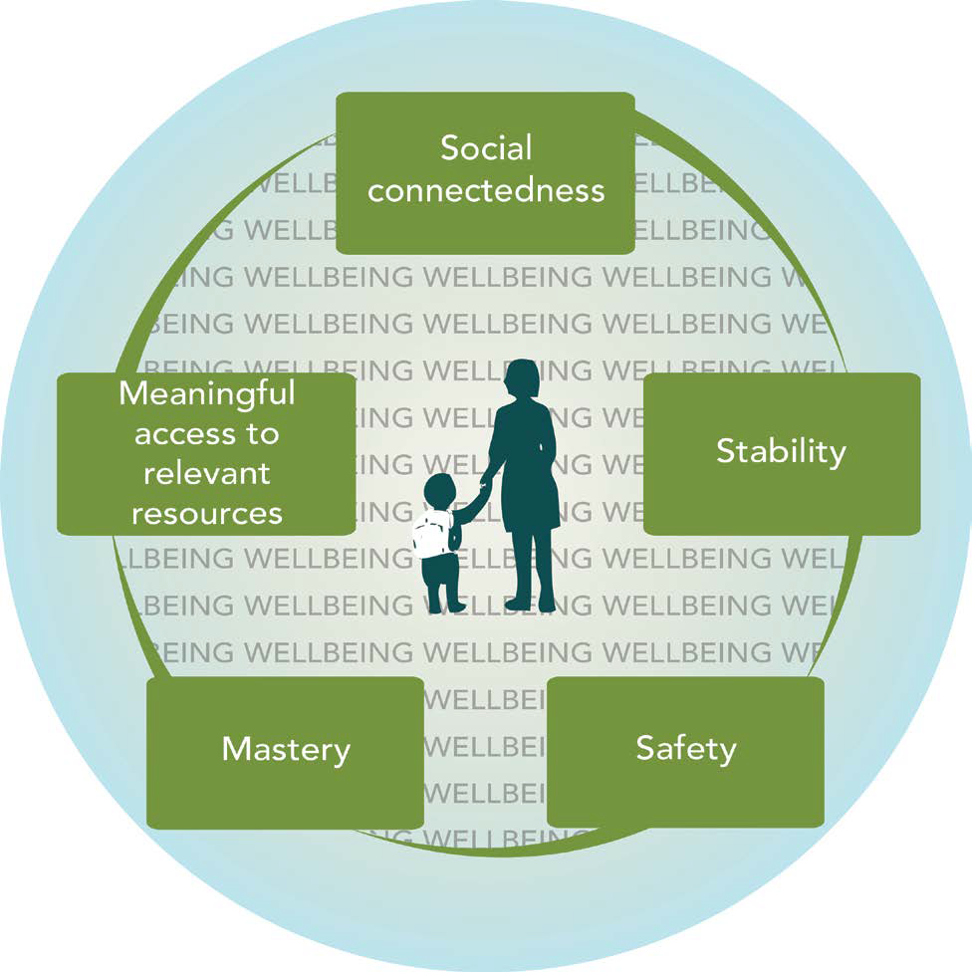

Slide 21
WHAT THE FIVE DOMAINS OF WELLBEING MEAN FOR INDIVIDUALS
Social Connectedness - The degree to which a person has and perceives a sufficient number and diversity of relationships that allow her or him to give and receive information, emotional support and material aid; create a sense of belonging and value; and foster growth.
Stability - The degree to which a person can expect her or his situation and status to be fundamentally the same from one day to the next, where there is adequate predictability for a person to concentrate on the here-and-now and on the future, growth and change; and where small obstacles don’t set off big cascades.
Safety - The degree to which a person can be her or his authentic self and not be at heightened risk of physical or emotional harm.
Mastery - The degree to which a person feels in control of her or his fate and the decisions she or he makes, and where she or he experiences some correlation between efforts and outcomes.
Meaningful Access to Relevant Resources - The degree to which a person can meet needs particularly important for her or his situation in ways that are not overly onerous, and are not degrading or dangerous.
Notes:
Social Connectedness - Related concepts: belonging, social capital, social networks, social support, reduced social isolation and exclusion
Stability - Related concepts: resiliency, permanency, certainty
Safety - Related concepts: security; absence of harm, risk or danger
Mastery - Related concepts: control, choice, self-efficacy, self-esteem, self-confidence, empowerment, applying knowledge
Meaningful Access to Relevant Resources - Related concepts: having knowledge, meeting “basic” needs, cultural competence (of resources), utilization rates, service integration/defragmentation, reduced barriers, information and referral, navigation

Slide 22
Tradeoffs: Decision, Choice and Change
When we decide if something is “worth it,” we are balancing tradeoffs.
When people make choices different from what we might expect or want, they may be weighting tradeoffs differently.
Sometimes we make (or are forced to make) change that involves significant tradeoffs that we or others never anticipated. If the tradeoffs are too big, we don’t sustain change.
Sometimes, we’re aware of tradeoffs.
Sometimes, we forget to think about them, especially for other people.
Notes:
This is where we all seem to fail. Professionals need to understand that everyone has to weigh their options. A person that is in rehab is many times told that they cannot hang around with the people that they use to hang around with. They must trade off social connection for safety. Is it worth it? Have we given them another viable option to have social connections that are meaningful and not judgmental.

Slide 23
Your Turn
Using the same case scenario as earlier
Using the five domains and identify in each what they have and what could be put in place to strengthen
  Social Connectedness
  Stability
  Safety
  Mastery
  Meaningful Access to Relevant Resources

Slide 24
Moving Franklin County Forward

Slide 25

BASED APPROACH

Slide 26

Teamwork is Essential

Slide 27

  INDIVIDUALIZED

Slide 28
Moving the cheese…
What we need…
What we don’t need…
Hold each other accountable
Keep it on the positive
Openness to other ideas and perspectives
Patience
Blame Game
Negativity
Those who think they have all the answers
Remember that implementation is a journey and like any journey, we need to pay attention to our map

Slide 29
Resources
www.franklincountykids.org
Annie Foncannon Schulte
  annie@franklincountykids.org
  636-234-7133

