Slide 1
Trafficking of Minors: What You Need to Know to Recognize and Respond to the Trafficking of Youth

Slide 2
Today’s Goals
Gain a greater understanding of the issue of human trafficking and its prevalence in schools and communities
Learn about indicators and warning signs of trafficking involvement

Slide 3
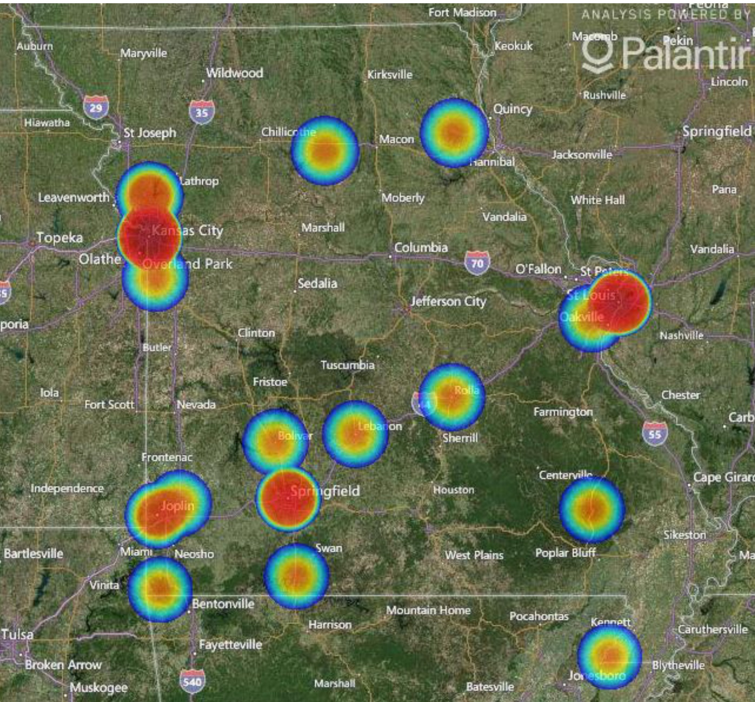

Slide 4
What is Trafficking?

Slide 5
What do you think?
True or False?
For an activity to be considered trafficking, the victim must have been transported across county or state lines.

Slide 6
Human Trafficking: The Basics
Human trafficking
Is a form of modern-day slavery where traffickers profit from the control and exploitation of their victims
Is a highly profitable global criminal enterprise, generating billions of dollars in annual profits
Operates according to the dynamics of supply and demand, allowing for multiple entry points into combatting trafficking

Slide 7
https://youtu.be/35uM5VMrZas

Slide 8
Trafficking Victims Under Federal Law
Minors (17 or younger)
involved in a commercial sex act
Adults (18 or older)
who are forced, defrauded, or coerced into committing commercial sex acts
Anyone (regardless of age)
who is forced, defrauded, or coerced into various forms of labor or services
Notes:
These are formal definitions taken from the Trafficking Victims Protection Act.

Slide 9
https://youtu.be/iqJ-zuVay08

Slide 10
The Venues
Online (social networks, Backpage, Craigslist)
Fake massage or spa business (Commercial Front)
Residential based commercial sex
Truck stops
Hotels/motels
Escort Services
Strip clubs
On the street via pimp- or gang-based
prostitution

Slide 12
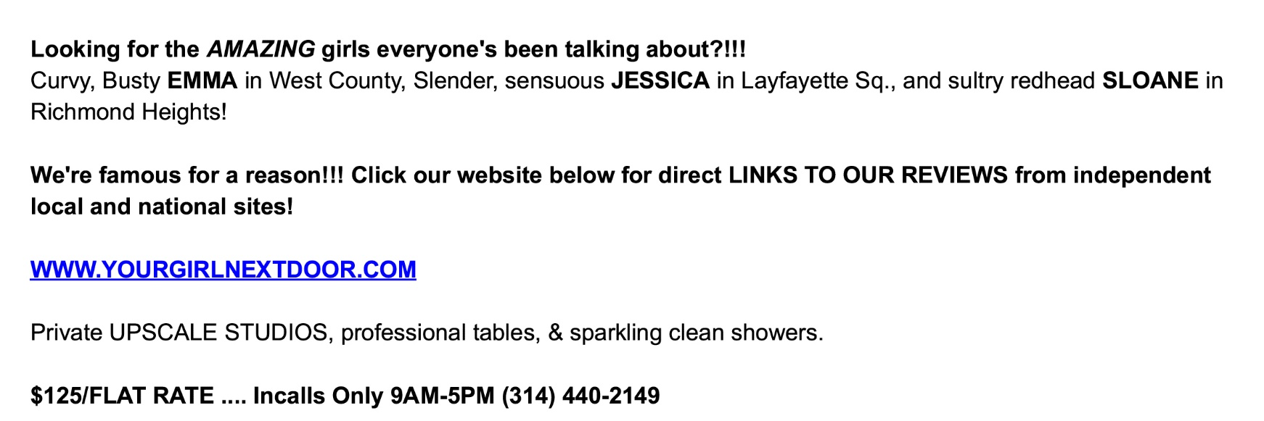

Slide 14
The Numbers

Slide 15
What do you think?
True or False?
It is estimated that 1/3 (33%) of youth victims of trafficking are runaway, thrownaway, or homeless youth

Slide 16
The Numbers
The number of 10- to 17-year olds involved in commercial sexual exploitation in the United States each year likely exceeds 250,000, with 60% of these victims being runaway, thrownaway, or homeless youth
Congressional testimony
Ernie Allen, President National Center for Missing and Exploited Children
http://judiciary.house.gov/_files/hearings/ pdf/allen100915.pdf

Slide 17
The Numbers
As many as one third of teen runaway or thrownaway youth will be approached by a trafficker within 48 hours of leaving home.

Slide 18
The Numbers
50%...
The percentage of minors served by Covenant House who engaged in commercial sex for a place to stay
Covenant House
http://www.covenanthouse.org/sites/default/files/attachments/Covenant-House-trafficking-study.pdf

Slide 19
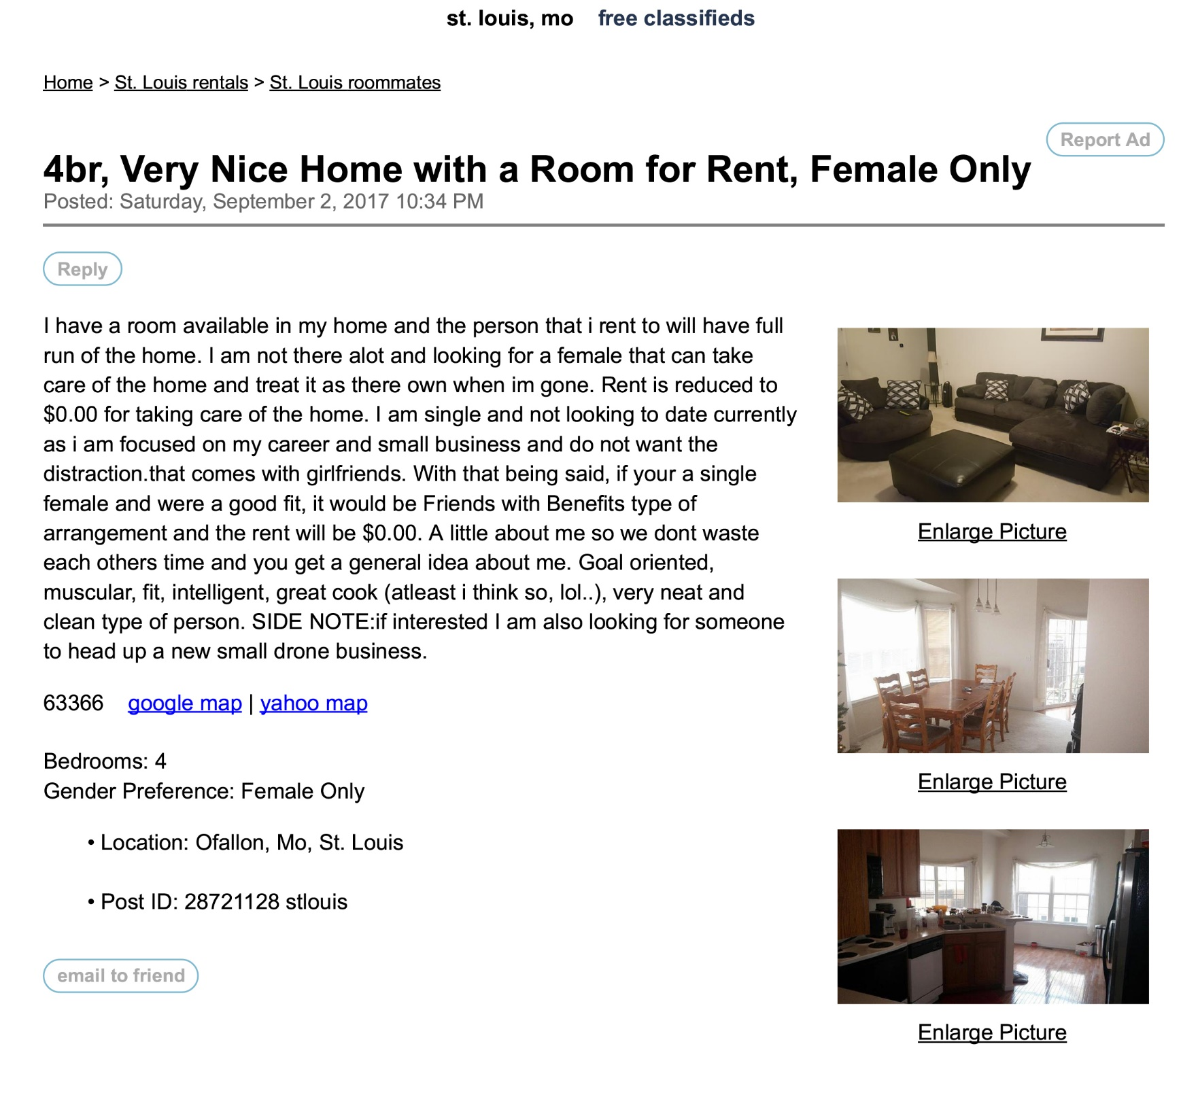

Slide 20
Polaris Project 2016 Statistics

Slide 21
Polaris Project 2014 Statistics

Slide 22
Age of Onset

Slide 23
Questions?

Slide 24
The Traffickers

Slide 25
What do you think?
True or False?
Trafficking victims usually know their traffickers prior to their being trafficked (boyfriend, friend, family member, etc.)

Slide 26
Traffickers come from
all walks
of life
and often
know the victim

Slide 27
The Traffickers
Covenant House
http://www.covenanthouse.org/sites/default/files/attachments/Covenant-House-trafficking-study.pdf

Slide 28
Traffickers
exploit
vulnerability
and
manipulate
Notes:
Traffickers are masters of manipulation and exploiting vulnerabilities
Target at-risk populations
Threats
Physical harm
Emotional manipulation
“Trauma bond”
Brainwashing

Slide 29
The Victims

Slide 30
What do you think?
True or False?
A history of child welfare involvement is widely considered to be a major contributor to increasing a minor’s vulnerability to trafficking.

Slide 31
“The themes of trauma, abandonment, and disruption, begun in childhood, are central to the narratives of adolescent girls trafficked into commercial sexual exploitation. Girls describe having had a profound sense of being alone without resources.”

Slide 32
12 to 14…
The average age at which girls first become victims of prostitution
11 to 13…
The average age at which boys and transgender youth first become victims of prostitution
Federal Bureau of Investigations
http://www.fbi.gov/stats-services/publications/law-enforcement-bulletin/march_2011/human_sex_trafficking

Slide 33
Victim Vulnerabilities
Homelessness/running away
1 in 6 Homeless Youth are Sex Trafficked, 1 in 3 Homeless Youth have engaged in sex trade (survival sex)
91% of Homeless Youth are approached for some type of labor trafficking
Economic vulnerability (poverty, lack of education, poor employment opportunities)
Prior experiences of abuse either physical and sexual
95% maltreatment and 49% sexual abuse

Slide 34
Victim Vulnerabilities
Age (inexperience, need to belong, self-esteem issues)
History of family drug use
LGBT
39% of youth sex trafficked were LGBT with the highest percentage being Transgendered

Slide 35
Victim Vulnerabilities
Lack of a support network, including a trustworthy adult
History of systems involvement (child welfare, juvenile justice)
Disabilities / Special Education Needs
Low Self Esteem, Self Confidence, or Self Worth

Slide 36
The Impacts
Physical injuries/health problems due to physical and sexual violence (broken bones, untreated wounds, STDs, reproductive health problems, malnutrition)
Mental and emotional health problems due to psychological trauma (PTSD, depression, anxiety, suicidal ideation, despair and hopelessness)

Slide 37
The Impacts
Substance abuse forced on the victim by the trafficker or used by the victim as a coping mechanism for abuse
Changed relationships with self and others (profound sense of shame and guilt, inability to trust)
Unhealthy bond with the perpetrator (“trauma bond”)

Slide 38
Levels of Involvement
Party Crews (Scouting & Recruitment) Still in school, beginning of the recruitment
Campus and Neighborhood Exploitation (Manipulating & Grooming) Still in school, truancy, decline in academic performance
Completely in “The Life”
(Trapping) No longer attending school, runaway, on the track and circuit

Slide 39
Warning Signs https://youtu.be/TQFQqU3O9GM
Unexplained school absences/irregular school attendance
Chronic running away
Homelessness
An abrupt change in attire, behavior, or relationships
The presence of an older “boyfriend” or “girlfriend”
Travel with an older male who is not a guardian
References to frequent travel to other cities
The sudden presence of expensive possessions

Slide 40
Warning Signs
Unusual attachment to cellphone
Lack of control over schedule, money, and/or proof of identification
Signs of psychological distress, such as depression, anxiety, paranoia, and/or suicidal ideation
Signs of psychological coercion, such as an overly submissive attitude or inability to speak for self
Signs of physical trauma, including bruises, cuts, burns, and/or scars

Slide 41
Warning Signs
Strange tattoos or other branding marks
Substance abuse or addictions
Poor health, as evidenced by sexually transmitted diseases, malnutrition, and/or serious dental problems
Inappropriate dress
“A reputation”
References to sexual situations beyond what is age-appropriate

Slide 42
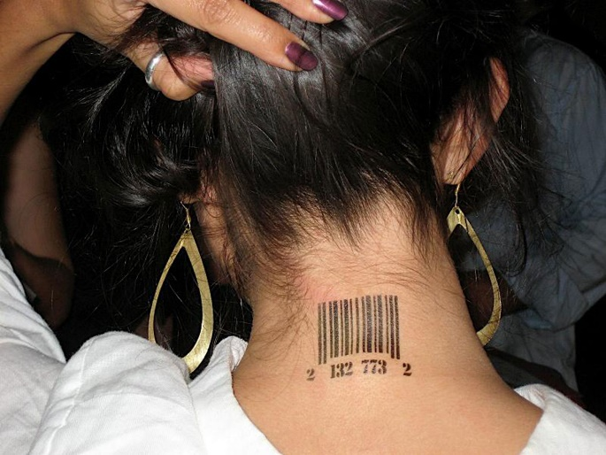
Tattoos/Marking/Branding

Slide 43
Labor Trafficking among Youth
Traveling Sales Crews (magazines / candy)
Selling magazines to earn points for x,y,z
Money stays on the books to cover expenses
Daily stipend for food ($10-$15)
10 – 14 hour days
Illegal Drug Distribution

Slide 44
https://youtu.be/aTAVZChvLR4

Slide 45
Questions?

